Slide 1
5G Mobility
The 5th generation wireless network

Slide 2
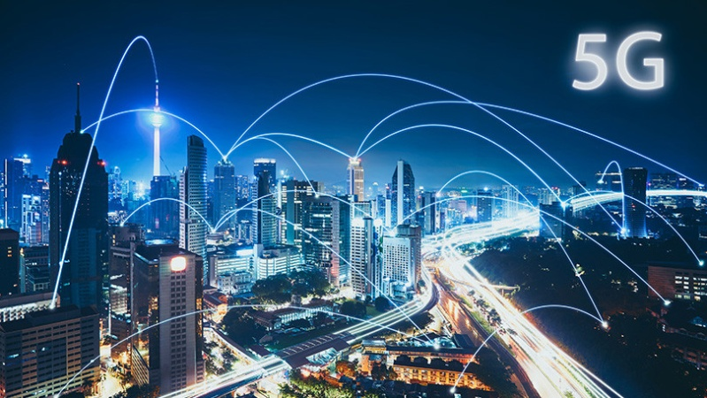
What is the Technology?
5G is the fifth generation of network technology.
5G network is set to be effective by 2020
5G generation of network connection takes on a large role when compared to the other generation of network connection.
5G will deliver multi-Gbps peak rates, huge capacity, and uniform experience for the user

Slide 3
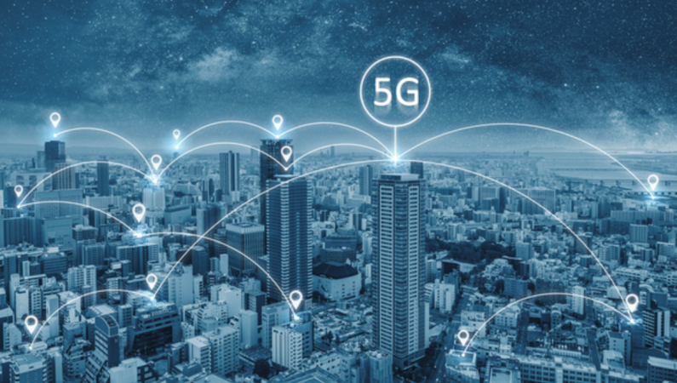
Cont’
Unlike the 4G LTE Technology, 5G aims to reach a high speed, reduced latency, and power, for massive use of internet
The 4G network has offered users access to a considerable speed of internet connection and reduced rates of latency.
5G network, however, focuses on interconnecting various things like machines to provide real-time interactivity

Slide 4
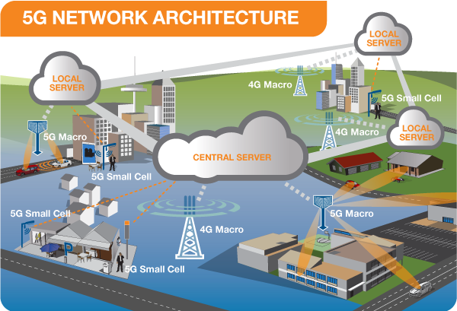
How does it Work?
The 5th generation wireless network expands broadband wireless services beyond the regular internet connection.
The 5th network uses various systems of cell sites and separate their territory to various sectors and send data that is encoded using radio waves.
The 5th generation wireless network also supports any form of communication with low power Local Area Network (LAN).
The 5th generation wireless network will improve human-level responses in real-time by adjusting the latency internet application

Slide 5
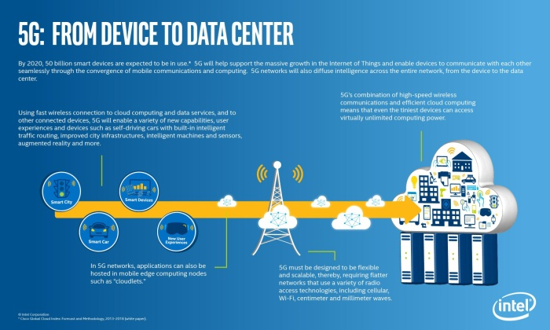
Cont’
The 5th generation network will double the speed from 4th generation wireless network
5G networks have high frequency and high-speed availability
It will deliver a different performance level and efficiency that will empower the experiences of users and connect new industries.

Slide 6
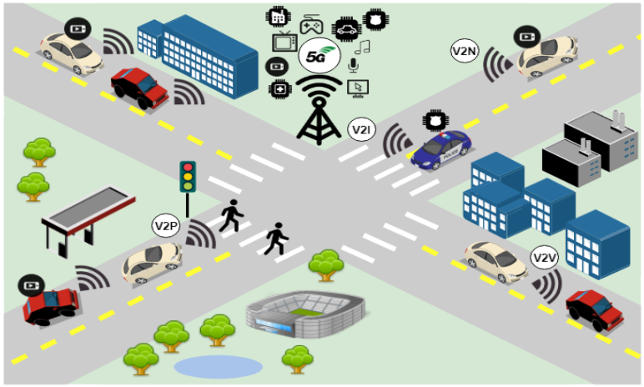
Who will Use it?
5G will enhance people’s connection to the internet, and it will introduce experiences like VR and AR, along with a fast, and a uniform rate of data, and reduced latency
5G will support all the communication needs in industries such as healthcare, automotive industries, and robotics application.
The technology will also be used for entertainment in games or watching movies without latency.

Slide 7
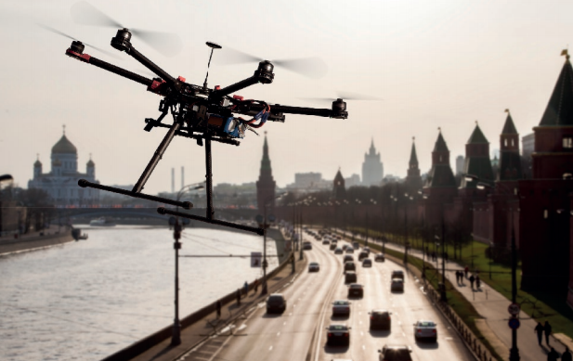
Cont’
5G will enhance people’s connection to the internet, and it will introduce experiences like VR and AR, along with a fast, and a uniform rate of data, and reduced latency
5G will support all the communication needs in industries such as healthcare, automotive industries, and robotics application.
The technology will also be used for entertainment in games or watching movies without latency.

Slide 8
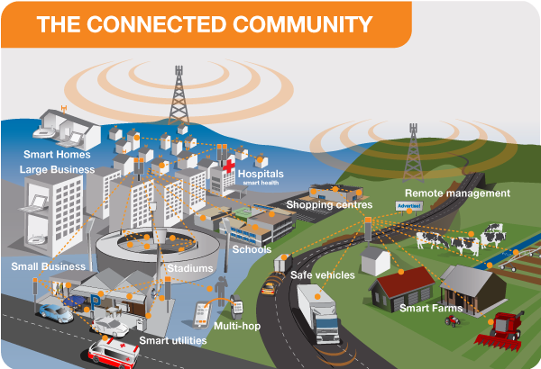
Why?
5G network is important because it will improve the way services are delivered in industries such as healthcare. For instance, it will allow surgeons to conduct real-time micromachining.
5G connection will revolutionalize the internet world through games and other related applications.
It will expand people’s experiences with the human senses such as sight, smell, touch, and hear to allow virtual reality user interfaces where the application will meet peoples’ sense for response time.
The technology will not only allow people to connect to the internet faster, but it will also improve connections in various other objects. Homes and cars are the two important examples of this innovative network connection.

